Slide 1
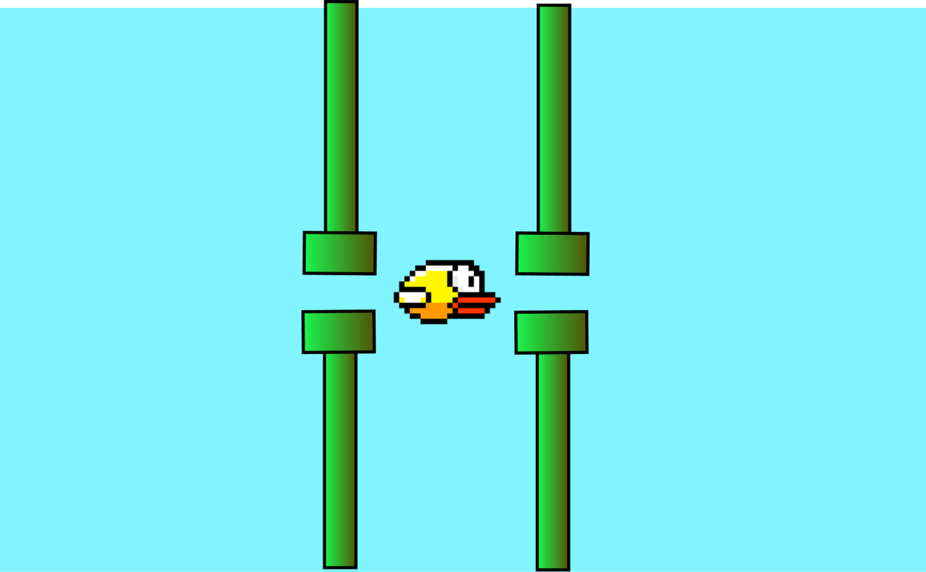
FLAPPY BIRD+
Made by: Anthony Liu

Slide 2
The idea
You've probably played Flappy bird before, and if you live under a rock, I'll explain the rules. A little bird tries to pass through pipes. Every time you pass through a pipe, your score increases by 1. It's pretty simple, but I decided to try to up it a notch.

Slide 3
How to play
The pipes now move, use spacebar or click the mouse button to jump. You'll have to pass through moving pipes that open and close on you. The jump height is a lot smaller than the original. The hitbox is also a lot bigger, which makes this even harder. Luckily, there is a pause button if you need to do something after getting a high score and continue playing after.

Slide 4
The Classes
Class Assets: The assets class manages audio and image files for the game.
Class PipeManager: This class manages the pipe's behavior, such as the open and closing behavior.
Class Bird: This manages the player, with all its attributes stored in variables and all actions that the player could do stored in functions
Class FlappyBirdGame: This class brings all of the class together to create the final result of the Flappy Bird Game.

Slide 5
The important functions
Handle Events (FlappyBirdGame): This method handles all the button control and key listening.
Update (PipeManager): This function makes the pipes move, updates every frame, and defines the open and close function for the pipes.
Jump (Bird): This defines the jump function in the flappy bird game.
Play_background_music (Assets): This function in the Assets file and it plays a background music to the game.

Slide 6
The problems and solutions
Problem 1: Getting a pair of pipes to change lengths
Solution: To change one of the pipe's direction to the negative which allows them to open and close in.
Problem 2: Detect incoming collision with the Bird and the Pipes
Solution: Using one of Pygame's built in functions, CollideRect(), which detects collision between two sprites, or Rects.
Problem 3: Buttons on losing screen will not respond when clicked
Solution: Removing the time.sleep line to remove delays for updating the screen and remove the sound.

Slide 7
Github link if you want to play :D
https://github.com/aliu12345/Flapbird

